Slide 1

An Avenger’s Guide to Power-up your ML Algorithms
Understanding Ensembles – Stacking, Bootstrapping, Bagging and Boosting

Slide 2

Content
Ensemble Methods
Stacking
Bootstrapping and Bagging
Random Forest
ExtraTrees
Boosting
AdaBoost

Slide 3
Ensemble Methods
Use multiple learning algorithms to obtain better predictive performance
Different methods of combining different algorithms
Stacking
Bootstrapping and Bagging
Random Forest - Stochastic Discrimination
Boosting
6.02 Later Part
Notes:
6.02 Later Part

Slide 4


Stacking
Different types of machine learning algorithms are trained on the same data.
A ‘combiner’ algorithm determines final results

Slide 5
Stacking
lr = LinearRegression()
lr.fit(X_train, y_train)
lr_y_pred = lr.predict(y_test)
dtr = DecisionTreeRegressor()
dtr.fit(X_train, y_train)
dtr_y_pred = dtr.predict(y_test)
knr = KNeighborsRegressor()
knr.fit(X_train, y_train)
knr_y_pred = knr.predict(y_test)
# combined results by averaging
combined_result = (lr_y_pred[0] + dtr_y_pred[0] + knr_y_pred[0]) / 3
Notes:
6.04 Codealong, VotingClassifier

Slide 6
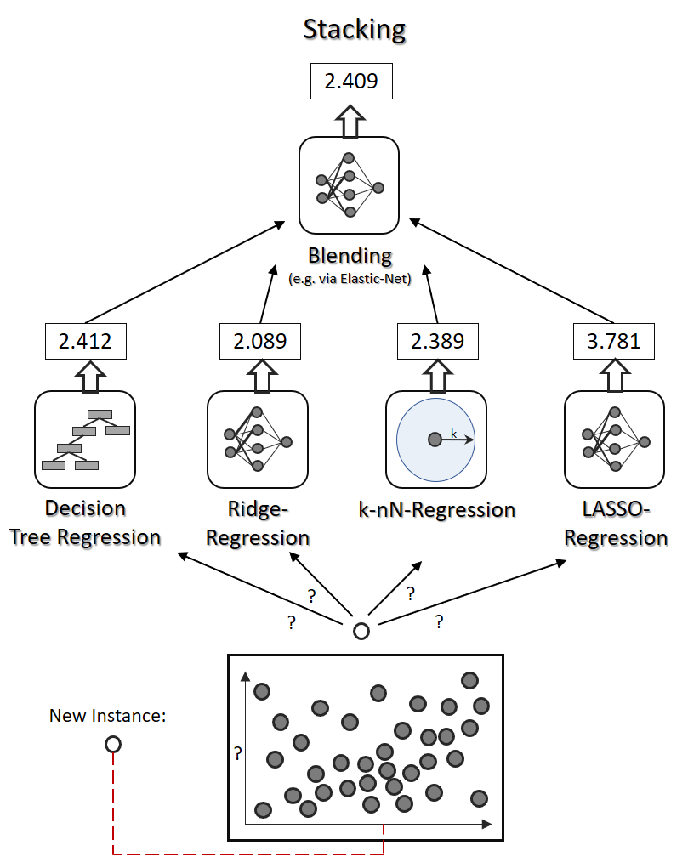
Stacking
Overall better model in terms of bias and variance
Can parallelize the fit proceses

Slide 7
Bootstrapping
Bootstrapping – random resampling with replacement.
Same concept as in statistics
https://medium.com/ml-research-lab/stacking-ensemble-meta-algorithms-for-improve-predictions-f4b4cf3b9237

Slide 8
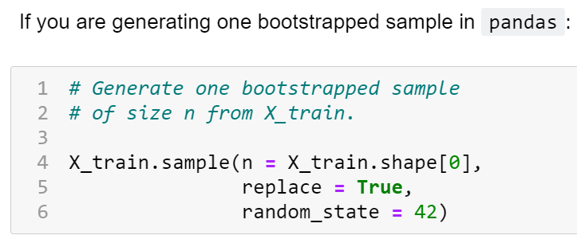
Bootstrapping
Notes:
6.02 - Bootstrapping

Slide 9

Bagging = Bootstrap Aggregation
Same types of machine learning algorithms are trained on the bootstrapped-sampled data (one model for each sample)
A ‘combiner’/aggregator algorithm determines final results
Notes:
6.02

Slide 10
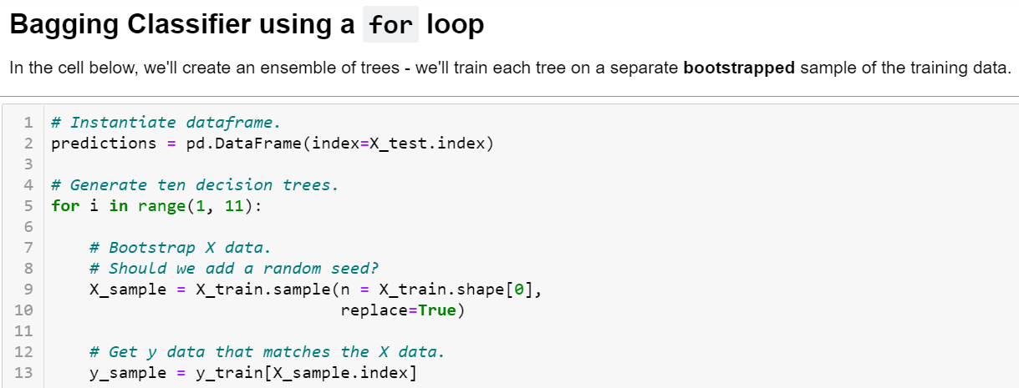
Bagging = Bootstrap Aggregation
Notes:
6.02

Slide 11
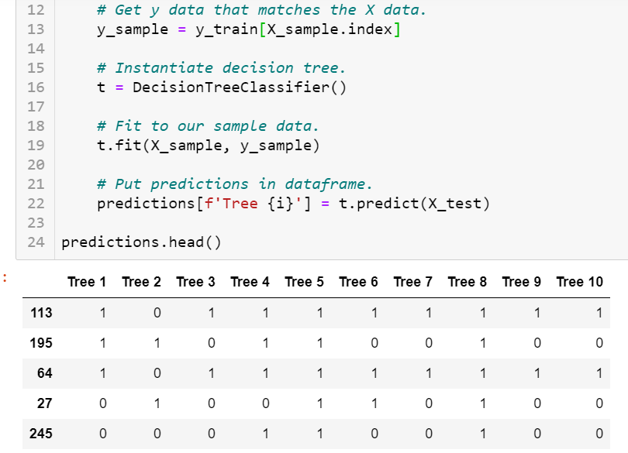
Bagging = Bootstrap Aggregation
Notes:
6.02

Slide 12
Bagged Decision Trees
Strongly correlated with other trees
High variance (overfit!)
Notes:
6.02 - Bootstrapping

Slide 13

Random Forest – Stochastic Discrimination
Random Forest = Bagging Decision Tree + Feature Bagging
Feature Bagging – Select a random subset of features for training each tree
Alternatively, can also have a random subset of features at each node!
Notes:
6.02 - Bootstrapping

Slide 14
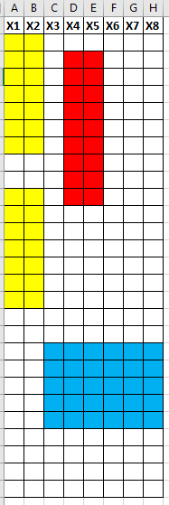



Random Forest – Stochastic Discrimination
Predict: Yes
Predict: Yes
Predict: Yes
Notes:
6.02 - Bootstrapping

Slide 15
ExtraTrees – Extremely Randomized Trees
ExtraTrees = Random Forest - Bootstrapping + randomness in node splits
Use the entire dataset
Has Feature Bagging (ie. subset of features)
Randomness in node splits
Don’t base the split on Gini Impurity for each feature
Instead, choose a random value from each feature’s range
Then amongst these randomly selected splits, choose the one with best ‘score’
This reduces variance, but increases bias
Algorithm is no longer ‘greedy’
Notes:
6.02 - Bootstrapping

Slide 17
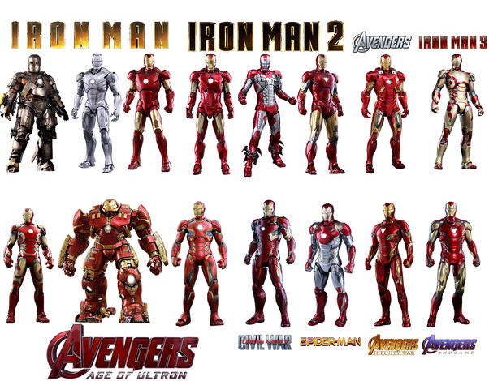
Boosting - Adaboost
Same types of machine learning algorithms are trained on the re-weighted data from the previous trained model.
Misclassified examples are given higher weight (ie. penalized more in the loss function).
A ‘combiner’ algorithm determines final results (based on error rates)
Slow – must train in sequence (like you must watch all the Iron Man movies in sequence)

Slide 18

Boosting - Adaboost

